Slide 1
Energy and Energy Types

Slide 2
Energy is the capacity to do work. Energy comes in various forms, such as motion ,heat , light, electrical, chemical, nuclear energy, and gravitational
Total energy is the sum of all forms of the energy a system possesses. In the absence of magnetic, electrical and surface tension effects, the total energy of a system consists of the kinetic, potential, and internal energies.
The internal energy of a system is made up of sensible, latent, chemical, and nuclear energies. The sensible internal energy is due to translational, rotational, and vibrational effects of atoms and molecules.
Thermal energy is the sensible and latent forms of internal energy.

Slide 3
chemical energy is the kind of potential energy stored in chemical bonds. Nuclear energy is the energy stored in interactions between the particles in the atomic nucleus.
Microscopic forms of energy are related to the molecular structure of a system and they are independent
of outside reference frames.
For example
1) Hydrogen represents a store of potential energy that can be released by fusion of hydrogen in the Sun.

Slide 4
2) Atmospheric phenomena like wind, rain, snow, and hurricanes, are all a result of energy transformations brought about by solar energy on the atmosphere of the earth.
3) Sunlight is captured by plants as chemical potential energy in photosynthesis, when carbon dioxide and water are converted into carbohydrates, lipids, and proteins.
This chemical potential energy is responsible for growth and development of a biological cell.
Unites
British thermal unit (Btu) is the energy unit in the English system
Calorie (cal) is the amount of energy in the metric system

Slide 5
Energy Types
Primary and secondary types of energy are the two main types.
1) Primary Energy
is the energy extracted or captured directly from the environment.
Three distinctive groups of primary energy are:
• Nonrenewable energy (fossil fuels): coal, crude oil, natural gas, nuclear fuel.
• Renewable energy: hydropower, biomass, solar energy, wind, geothermal, and ocean energy.
• Waste.

Slide 6
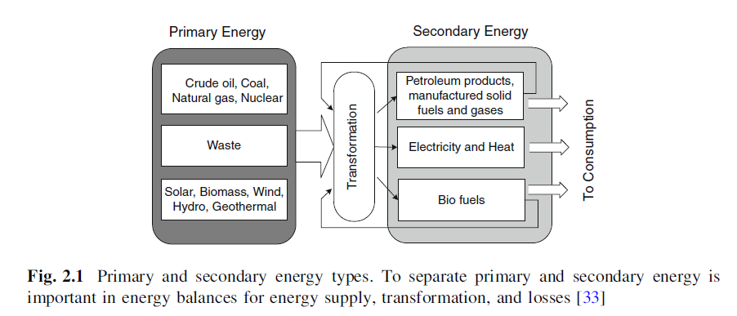
2) Secondary Energy
The primary energy is transformed to secondary energy in the form of electrical energy or fuel, such as gasoline, fuel oil, methanol, ethanol, and hydrogen.

Slide 8
Non Renewable Energy Sources
Major nonrenewable energy sources are:
• Coal
• Petroleum
• Natural gas
• Nuclear

Slide 9
1) Coal
Coals are sedimentary rocks containing combustible and incombustible matters as well as water.
The poorest lignite has less than 50% carbon and an energy density lower than wood.
Anthracites have more than 90% carbon. It is very hard and shiny and the ultimate maturation. It creates a steady and clean flame and is preferred for domestic heating . Furthermore it burns longer with more heat than the other types.
Bituminous coals mostly between 70 and 75%. Bituminous coal ignites easily and burns with a relatively long flame. If improperly fired, bituminous coal is characterized with excess smoke and soot. Anthracite.

Slide 10
2) Petroleum (Crude Oil)
Oil is a naturally occurring flammable liquid consisting of a complex mixture of hydrocarbons of various molecular weights.
The composition of hydrocarbons ranges from as much as 97% by weight in the lighter oils to as little as 50% in the heavier oils.

Slide 11
3) Petroleum Fractions
Oil is refined and separated into a large number of commodity products. Some common fractions from petroleum refining are:
a- Liquefied petroleum gas (LPG) is a flammable mixture of propane (C3H8) (about 38% by volume) and butane (C4H10) (about 60% by volume).used as a fuel in heating appliances and vehicles.
b- Gasoline is primarily used as a fuel in internal combustion engines. A typical gasoline consists of hydrocarbons with between 4 and 12 carbon atoms per molecule.
c- Petroleum diesel contains 8–21 carbon atoms per molecule with a boiling point in the range of 180–360C

Slide 12
d- Kerosene is a thin, clear liquid formed containing between 6 and 16 carbon atoms per molecule.
e- Jet fuel is a type of aviation fuel designed for use in aircraft powered by gas turbine engines.
f- Fuel oil is made of long hydrocarbon chains, particularly alkanes, cycloalkanes, and aromatics and heavier than gasoline and It is classified into six classes, numbered 1 through 6, according to its boiling point, composition, and purpose.
4) Natural Gas
is a naturally occurring mixture, consisting mainly of methane. Natural gas provides 23% of all energy consumed in the world.
a- liquefied natural gas
The volume of the liquid is approximately 1/600 of the gaseous volume at atmospheric conditions.

Slide 13
5) Nuclear Energy
plants produce electricity through the fission of nuclear fuel, such
as uranium, so they do not pollute the air with harmful gases.
Nuclear fission is a nuclear reaction in which the nucleus of an atom splits into smaller parts, often producing free neutrons and photons in the form of gamma rays and releasing large amounts of energy.

Slide 14
Heating Value of Fuels
• The higher heating value (HHV) consists of the combustion product of water condensed and that the heat of vaporization contained in the water vapor is recovered. So the all the water produced in the combustion is in liquid state.
• The lower heating value (LHV) assumes that the water product of combustion is at vapor state and the heat of vaporization is not recovered.
• Net heating value is the same with lower heating value and is obtained by
subtracting the latent heat of vaporization of the water vapor formed by the
combustion from the gross or higher heating value.
• The gross heating value is the total heat obtained by complete combustion at constant pressure including the heat released by condensing the water vapor in the combustion products. Gross heating value accounts liquid water in the fuel prior to combustion, and valuable for fuels containing water, such as wood and coal. If a fuel has no water prior to combustion then the gross heating value is equal to higher heating value.

Slide 15
A common method of relating HHV to LHV per unit mass of a fuel is :
Where :
∆Hvap is the heat of vaporization per mole of water (kJ/kg or Btu/lb).
nH2O;out is the moles of water vaporized,. nfuel,in is the number of moles of fuel combusted. MW is the molecular weight.
Energy Density
Energy density is the amount of energy per unit volume. Specific energy is the amount of energy per unit amount.
For example, the effectiveness of hydrogen fuel to gasoline, hydrogen has a higher specific energy than gasoline but a much lower energy density even in liquid form.

Slide 16
Renewable Energy Resources
Major renewable energy sources are:
• Hydroelectric
• Solar energy
• Biomass
• Wind
• Geothermal heat
• Ocean
renewable energy comes directly from the sun, or from heat
generated deep within the earth.
New and emerging renewable energy technologies are still under development and include cellulosic ethanol, hot-dry-rock geothermal power, and ocean energy.

Slide 17
1- Hydroenergy
Most hydroelectric energy comes from the potential energy of dammed water driving a water turbine and generator.
The power extracted from the water depends on the volume
and on the difference in height between the source and the water’s outflow.
2- Solar Energy
Solar powered electrical generation relies on photovoltaic and heat engines.
Other solar applications
includes space heating and cooling through solar architecture, daylighting, solar hotincludes space heating and cooling through solar architecture, daylighting, solar hot water, solar cooking, and high temperature process heat for industrial purposes.water, solar cooking, and high temperature process heat for industrial purposes.

Slide 18
Biomass and Bioenergy
Gross Heating Values of Biomass Fuels
Biomass fuels are usually characterized by the proximate and ultimate analyses.
• The proximate analysis gives moisture content, volatile content (when heated to 950C), the free carbon remaining at that point, the ash (mineral) in the sample, and the higher heating value based on the complete combustion of the sample to carbon dioxide and liquid water.
• The ultimate analysis is the elemental analysis and provides the composition of the biomass in wt% of carbon, hydrogen, oxygen, sulfur, and nitrogen.

Slide 19
A relationship between the high heating value, HHV and the elemental composition is given by:
Where:
C is the weight fraction of carbon,
H weight fraction of carbon of hydrogen,
O weight fraction of oxygen,
A weight fraction of ash, S weight fraction of sulfur,
N weight fraction of nitrogen appearing in the ultimate analysis. This equation represents the experimental data with an average error of 1.45% and can be used in estimating heat values and modeling of biomass processes.

Slide 20
Based on chemical functional groups of the fuels, the heating values may vary.
By using the values of fixed carbon (FC, wt%), the higher heating value of the biomass samples can be estimated by:
Another correlation between the HHV and dry ash content from proximate analysis of biomass (in weight percent) is expressed by:
Based on the composition of main elements (in wt%) C, H, and O, the heating value is estimated by:

Slide 23
BIO ENERGY
Part(1)

Slide 24
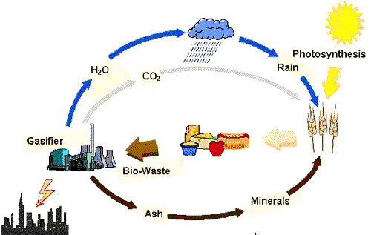
BIO ENERGY
Bioenergy is energy derived from biomass and biogas source. It is a renewable energy source.

Slide 25
BIOMASS
Biomass is organic matter from plants, micro- -organism grown on land and water and their derivatives. The energy obtain from biomass is also called the biomass energy. It is a renew- -able energy source. Because organic matter generated everyday. Coal, petroleum, natural gas are not come in biomass category because they produce from dead, burried biomass under high pressure and temperature during several millions of year.

Slide 26
Type of biomass
Biomass are classified in three group…..
Biomass from cultivated like fields, crops, forests etc.
Biomass derived from wastes like municipal waste, animal dung etc.
Biomass converted into liquid fuels.
Then
In first group the biomass is directly converted into energy by burning the biomass.

Slide 27
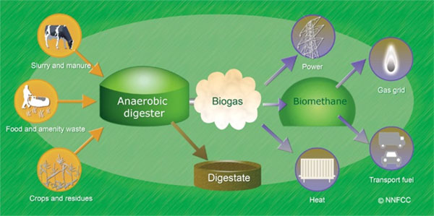
Second group the biomass is fermented anaerobically to obtain gaseous fuel like bio-gas.

Slide 28
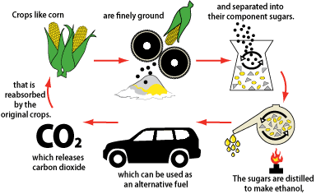
In third group biomass is converted into ethanol and methanol to use in a liquid fuels in engine.

Slide 29
Biomass power generation technologies
PART (2)

Slide 31
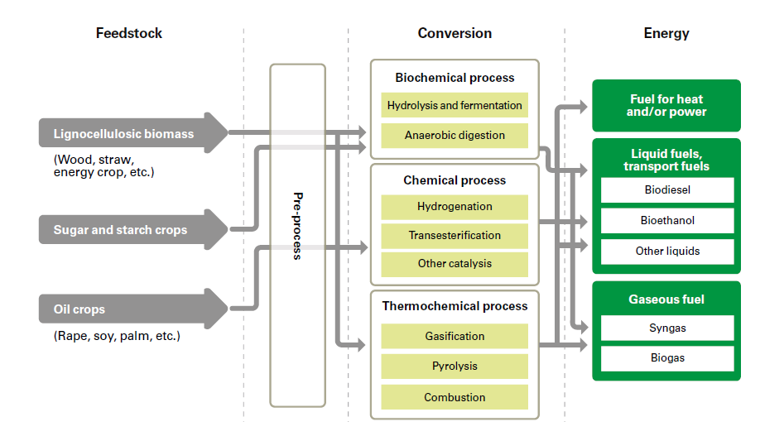

Slide 32
Biomass power generation
technologies
There can be many advantages to using biomass instead of fossil fuels for power generation, including lower greenhouse gas (GHG) emissions, energy
cost savings, improved security of supply, waste management/reduction opportunities and local economic development opportunities.
Thermo-Chemical Process
Bioenergy can be converted into power through : thermal-chemical processes (i.e. combustion, gasification and pyrolysis) or bio-chemical processes like anaerobic digestion.

Slide 33
Thermo-Chemical Process
1- Combustion : The cycle used is the conventional rankine cycle with biomass being burned (oxidized)in a high pressure boiler to generate steam. The net power cycle efficiencies that can be achieved are about 23% to 25%.
2- Gasification :Gasification is achieved by the partial combustion of the biomass in a low oxygen environment, leading to the release of a gaseous product (producer gas or syngas). The gasified can either be of a “fixed bed”, “fluidised bed configuration. The resulting gas is a mixture of carbon monoxide, water, CO2, char, tar and hydrogen, and it can be used in combustion engines, micro-turbines, fuel cells or gas turbines. Not include an intermediate conversion process.
3- Pyrolsis :is a subset of gasification systems. in pyrolysis, the partial combustion is stopped at a lower temperature (450°C to 600°C), resulting in the creation of a liquid bio-oil, as well as gaseous and solid products. The pyrolysis oil can then be used as a fuel to generate electricity.

Slide 34
Bio-Chemical Process
Anaerobic Digestion : anaerobic digestion is a process which takes place in almost any biological material that. The resulting gas consists mainly of methane and carbon dioxide and is referred to as biogas. The biogas can be used, after clean-up, in internal combustion engines, micro-turbines, gas turbines, fuel cells and starling engines or it can be upgraded to biomethane for distribution.
BIOMASS COMBUSTION TECHNOLOGIES
Around the globe, over 90% of the biomass that is used for energy purposes
goes through the combustion route. There are two main components of a combustion–based biomass plant:
1) the biomass-fired boiler that produces steam; and 2) the steam turbine, which is then used to generate electricity.

Slide 35
The two most common forms of boilers are stoker and fluidized bed. These can be fuelled entirely by biomass or can be co-fired with a combination of
biomass and coal or other solid fuels.
BOILER TYPES Stoker boilers :burn fuel on a grate, producing hot flue gases that are then used to produce steam.
There are two general types of stokers. Underfeed boilers supply both the fuel and the air from under the grate. Overfeed boilers supply the fuel from above the grate and the air from below.
Fluidised bed boilers :suspend fuels on upward blowing jets of air during the combustion process. They are categorized as either atmospheric or pressurized units. Atmospheric fluidized bed boilers are further divided into bubbling-bed and
circulating-bed units.
Difference between bubbling-bed and circulating-bed boilers is the fluidisation velocity (higher for circulating).
atmospheric-bubbling fluidised bed boilers are more commonly used when the
fuel is biomass.

Slide 36
The steam produced in the boilers is injected into steam turbines. There are three major types of turbines with each one having its own specific characteristics.
Major types of turbines:
1- Condensing Steam Turbine.: designed to obtain the maximum amount of shaft work out of a given steam input.
2- Extraction Steam Turbine : it is designed to allow steam to be extracted from the turbine at intermediate pressures in the middle part of the turbine. This is desirable for combined heat and power systems. This type of turbine offers a high flexibility of operation but at the expense of electrical efficiency.
3- Backpressure Steam Turbine : design is mostly used when a constant supply of heat is required. Backpressure turbines discharge steam at high temperatures and pressures. Backpressure turbine will produce lower amounts of shaft power and have a lower electrical efficiency. Used in Brazil in the sugar cane industry (cheaper )

Slide 37
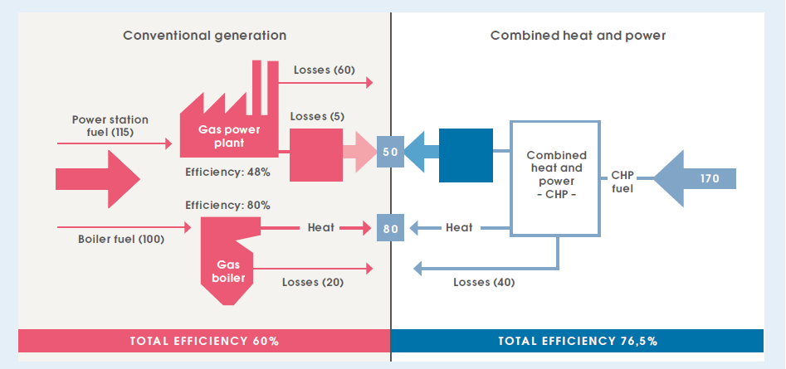
COMBINED HEAT AND POWER (CHP)
It is the simultaneous production of electricity and heat from one source of energy.
CHP systems can achieve higher overall efficiencies than the separate production of electricity and heat. The co-firing of biomass with coal in large coal-fired power plants is becoming increasingly common.
The advantage of biomass co-firing is that, on average, electric efficiency in
co-firing plants is higher than in dedicated biomass combustion plants.

Slide 38
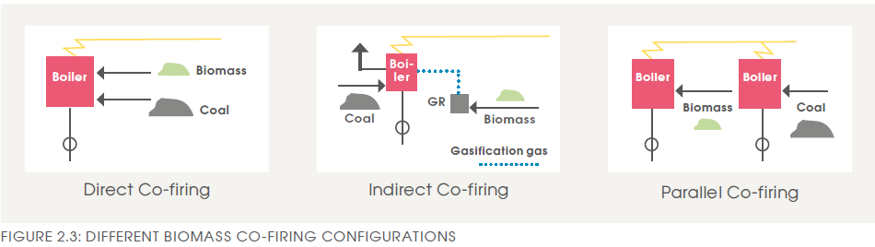
The incremental investment costs are relatively low although they can increase the cost of a coal-fired power plant by as much as a third.
There are three possible technology set-ups for co-firing :
1-» Direct co-firing, whereby biomass and coal are fed into a boiler with shared or separate burners.
2-» Indirect co-firing, whereby solid biomass is converted into a fuel gas that is burned together with the coal.
3-» Parallel co-firing, whereby biomass is burned in a separate boiler and steam is supplied to the coal-fired power plant.
In general, fluidized bed boilers can substitute higher levels of biomass than
pulverised coal-fired or grate-fired boilers. Dedicated biomass co-firing plants can run up to 100% biomass.

Slide 39

Biogas plant history ,designs and energy calculations
Part (3)
Electricity production from biogas

Slide 40
Biogas??
Biogas typically refers to a mixture of gases produced in result of breakdown of organic matter by the process of anaerobic fermentation.
Composition
Methane (CH4) 40-75% Water (H2O) 0-10%
Carbon dioxide (CO2) 25-55% Hydrogen sulfide(H2S) 1-3%
Ammonia (NH3) 0-1% Nitrogen (N2) 0-5%
Oxygen (O2) 0-1% Hydrogen (H2) 0-1%

Slide 41
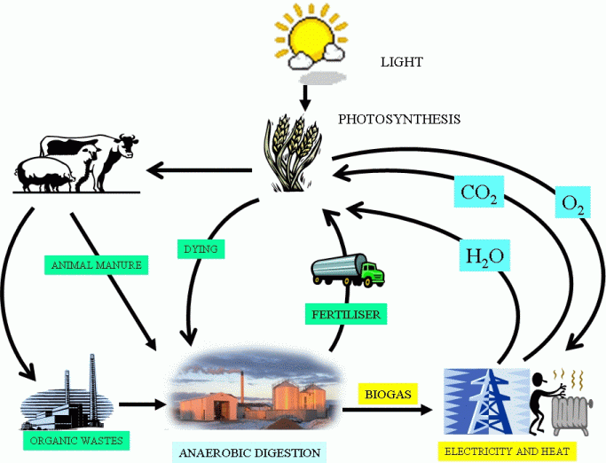
Introduction
Notes:
Many of you may heard the term of bio-renewable energy. Like,using corn to make ethanol is a good exmaple of coverting biomass to produce renewable energy. Biomass can be defined as organic matter formed by photosynthetic capture of solar energy and stored as chemical energy which includes crops and crops residues, animal manure, organic wastes as shown in this picture. The solar energy stored in biomass could be released as biogas through anaerobic digestion. Biogas could be then used to produce electricity and heat as renewable energy.

Slide 42
Anaerobic Digestion
Anaerobic digestion (AD)
  Organic Matter + H2O + Bacteria
  CH4 + CO2 + NH3 + H2S
  Traditionally
    Single substrate and single purpose
      Manure was digested to produce energy
      Sewage sludge should be stabilized
      Industrial waste water should be pre-treated
  Recently
      Co-digestion of two or more substrate and multi-purpose
Notes:
As we learned in the class, anaerobic digestion is a process that bacteria break down organic matter in absence of oxygen and produce biogas consisting of methane, carbon dioxide, and other trace gases (ammonia, h2s). In the past, anaerobic digestion was single substrate, and single purpose treatment. …. After year 2000, co-digestion of two or more substrate has become a hot topic.

Slide 43
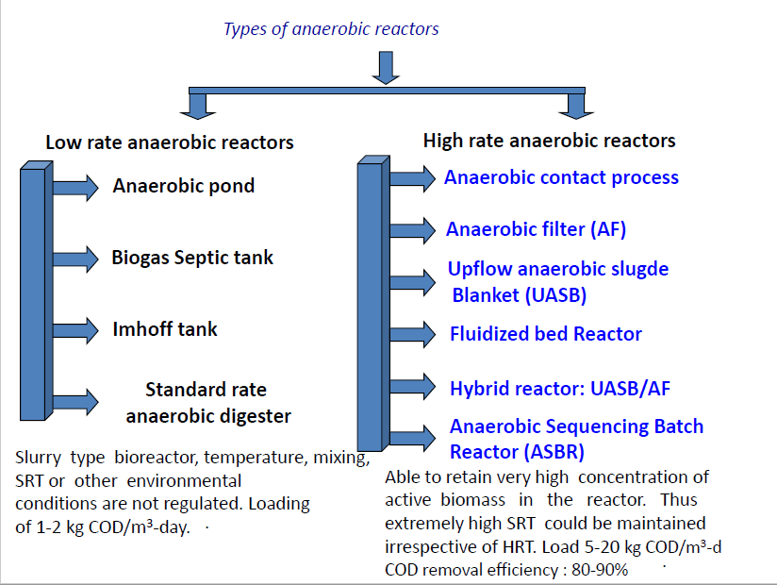

Slide 44
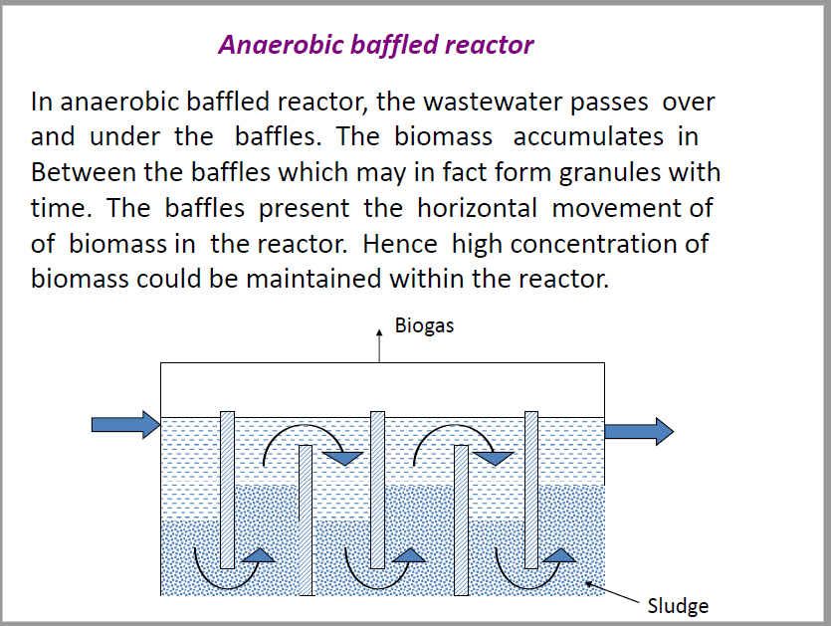

Slide 45
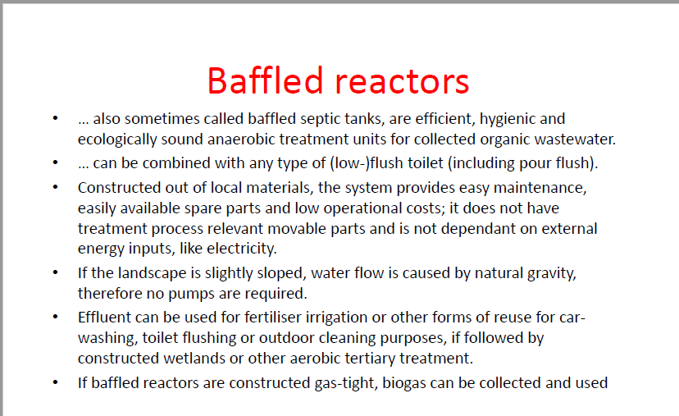

Slide 46
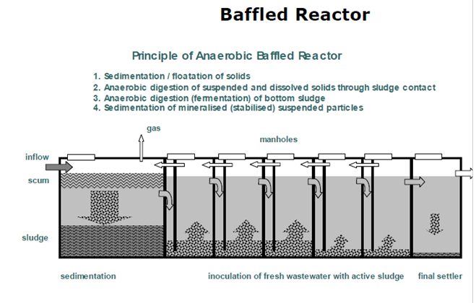

Slide 47
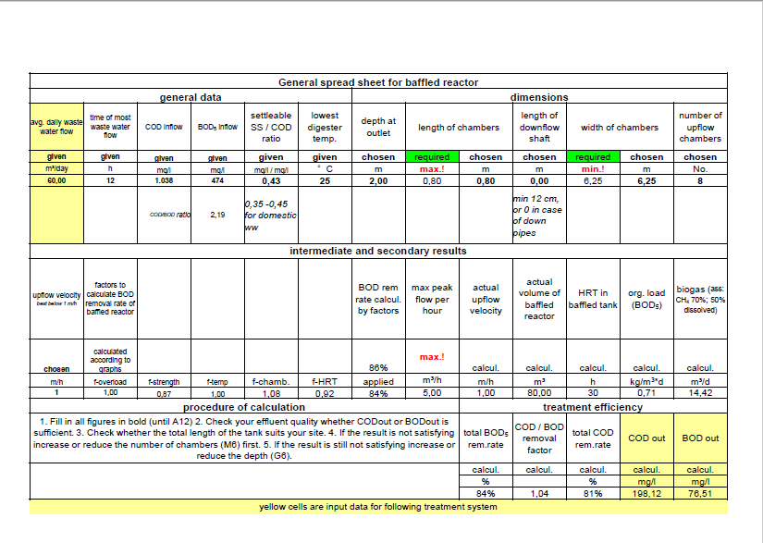

Slide 48

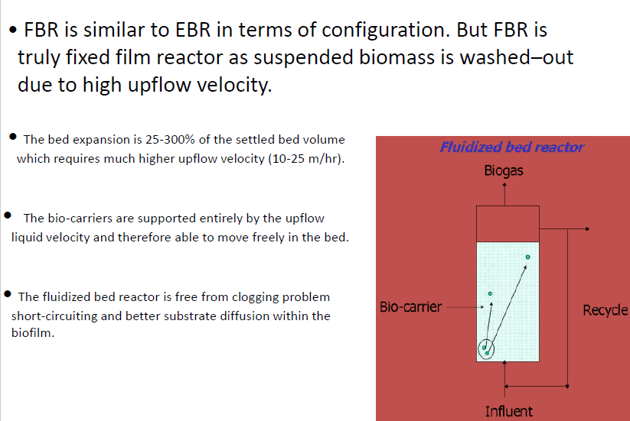

Slide 49
Introduction of biogas plant
Biogas plant is name often given to an anaerobic digester that treats farm or organic wastes.
The history of biogas plants goes back to ancient Persia and China. It was observed that rotting vegetables produce flammable gas.

Slide 50
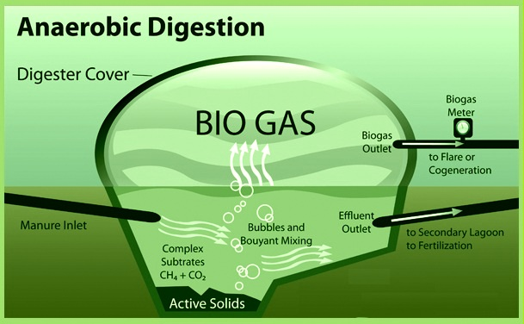
Basics behind biogas production

Slide 51
Types of biogas plants
1) The fixed dome type of biogas pant:
A fixed-dome plant consists of a digester with a fixed, non-movable gas holder, which sits on top of the digester. When gas production starts, the slurry is displaced into the compensation tank.
Benefits:
-The costs of a fixed-dome biogas plant are relatively low. It is simple as no moving parts exist.
- There are also no rusting steel parts and hence a long life of the plant (20 years or more) can be expected.
-The plant is constructed underground, protecting it from physical damage and saving space.

Slide 52
2) The floating gas holder type biogas plant
A floating-drum plant consists of a cylindrical or dome-shaped digester and a moving, floating gas-holder, or drum. The gas-holder floats either directly in the fermenting slurry or in a separate water jacket.
Benefits:
-Floating-drum plants are easy to understand and
operate.
-They provide gas at a constant pressure, and the
stored gas-volume is immediately recognizable
by the position of the drum.

Slide 53
3) Bag type biogas plant
The bag-type plant is manufactured high-strength PVC-polyester fabric and other compounds.
Benefits
More efficiency
No gas leakage

Slide 54
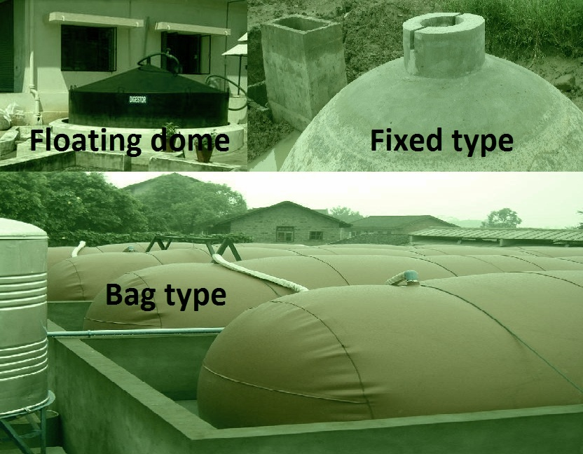
All three types

Slide 55
Construction of biogas plant
Part(4)

Slide 56
Construction of biogas plant
Site selection for biogas plant:
-To make plant operation easier and to avoid wastage of raw feedstock -The plant must be as close as possible to the feedstock supply and water source.
-The edge of the foundation of the plant should be at least two meters away from any other structures to avoid risk of damage during construction.

Slide 57
Carrying dung from shed to biogas plant:
On-farm biogas plants are feed with animal dung from adapted animal sheds, mixed with water and channel it into fermentation pits. These specified channels are so inclined that water mixed dung spontaneously flow toward the biogas plant therefore no extra labor is required to carry it.
If farmer is unable to afford the collection of dung by channels so it could be manual (carry & put) so no cost of construction for building these specific channels

Slide 58
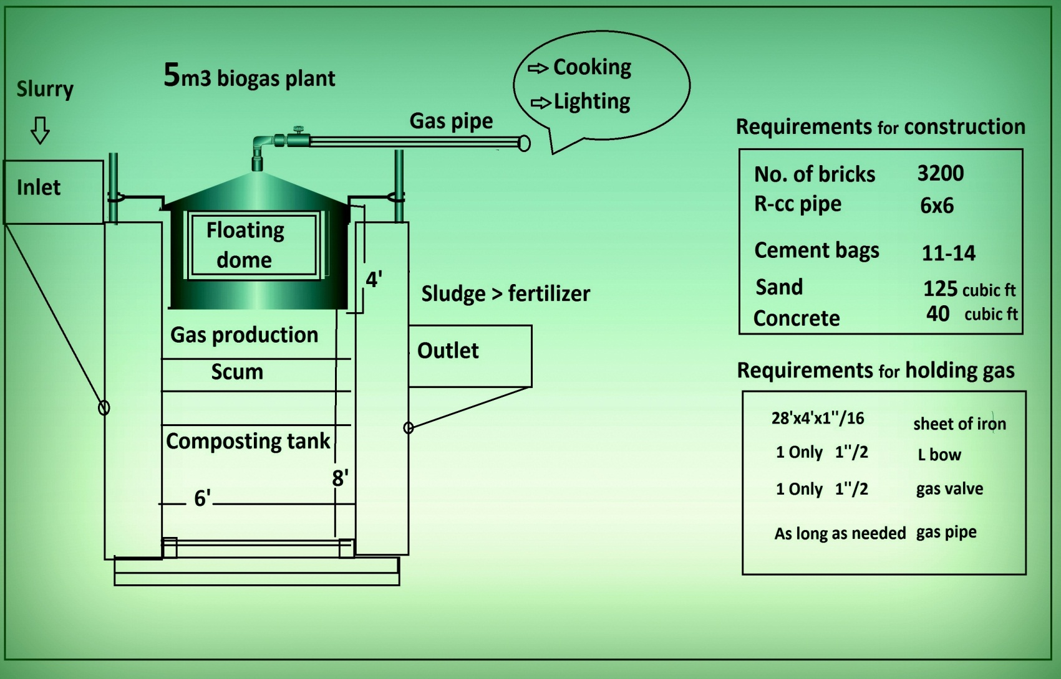
Requirements for 5m3 plant

Slide 59
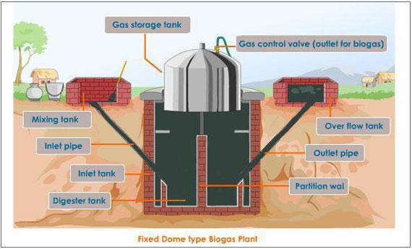
Fixed-Dom Type

Slide 60
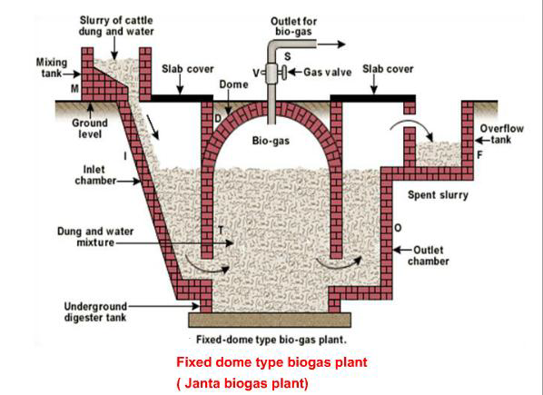

Slide 61
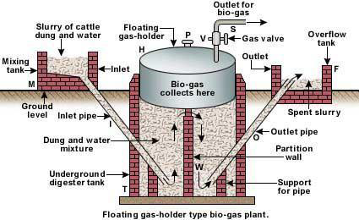
Floating Drum plants

Slide 62
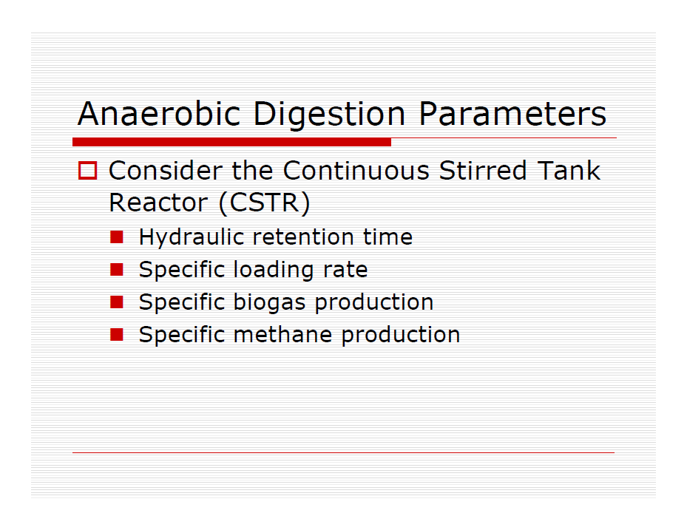
* The heat of combustion is called the upper calorific value,
* example of the solid fuel is wood. The dry weight of wood contains about 50% carbon, 6.3% hydrogen and 44.2% oxygen. During the combustion of wood we obtain relatively small (0.3- 1%) amount of ash. Wood is classified as biomass.
Anaerobic digester parameters
Biogas production
Digester heat balance

Slide 64
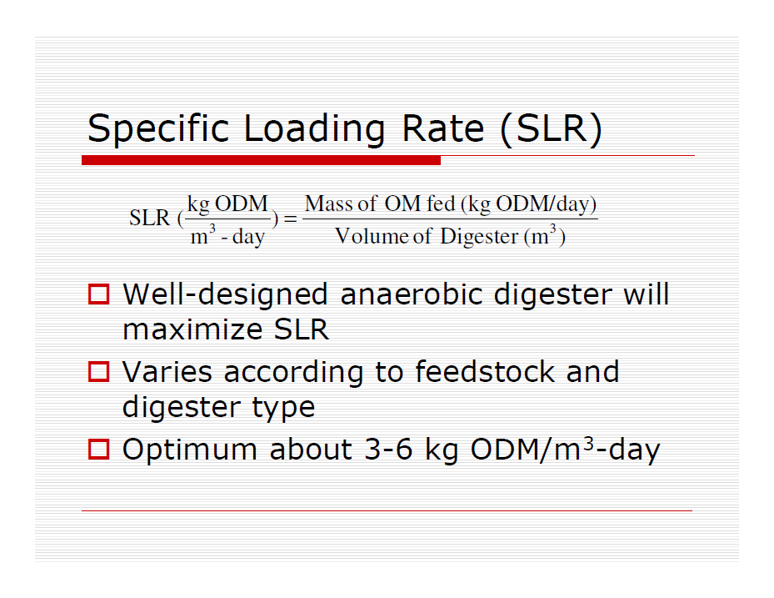

Slide 65
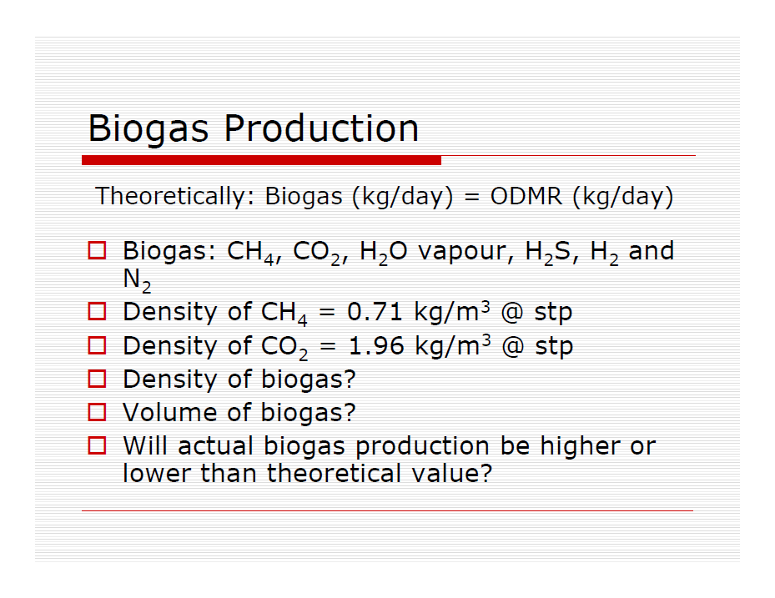

Slide 66
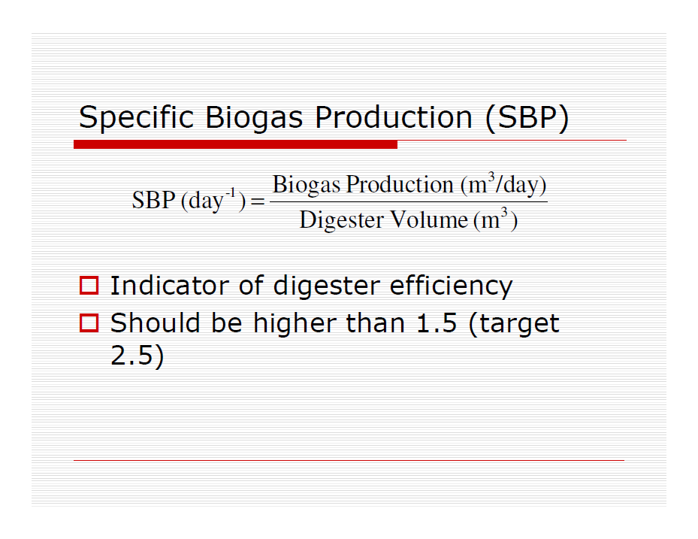

Slide 67
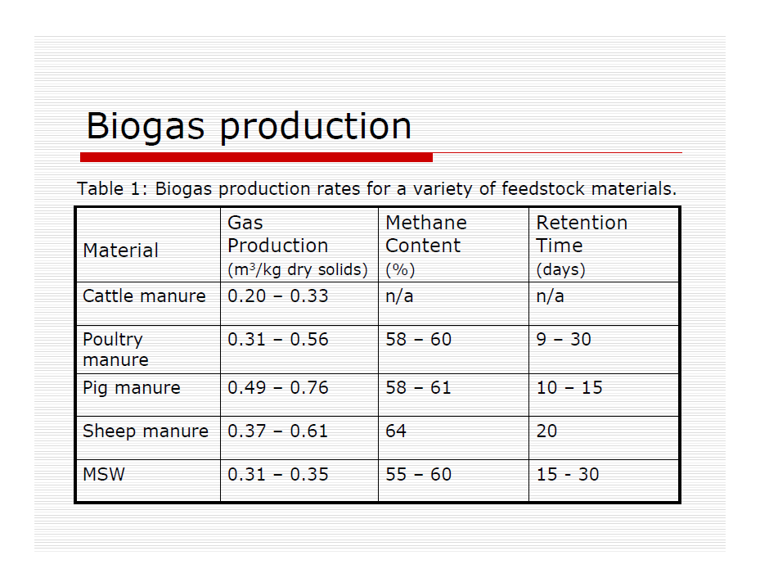

Slide 68
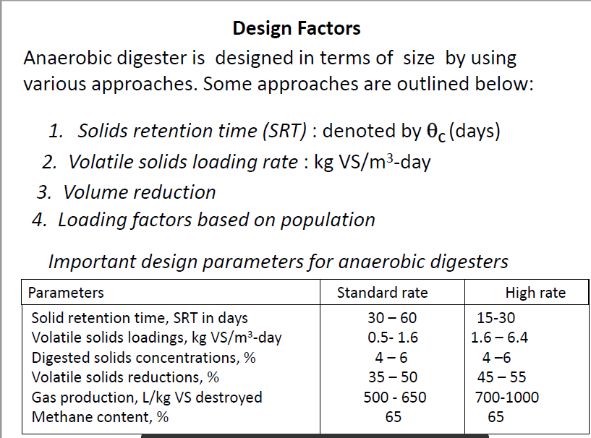
Review

Slide 69
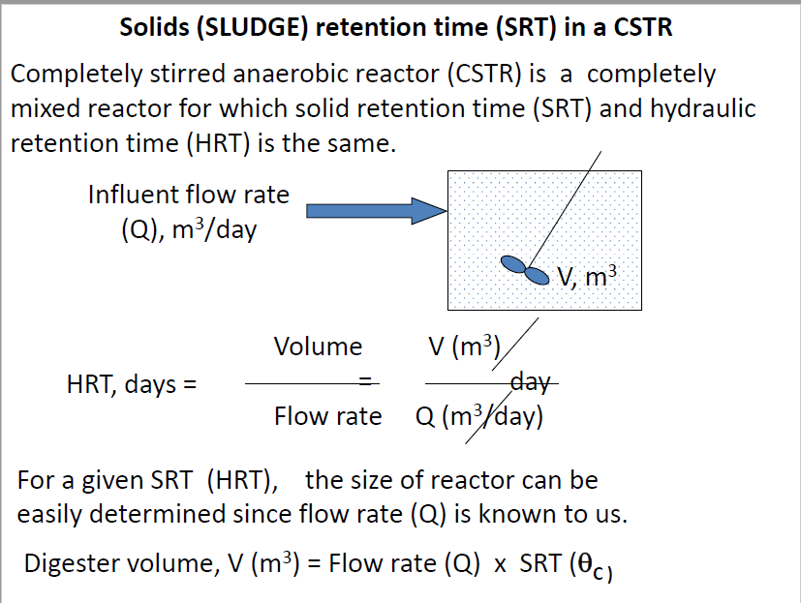

Slide 70
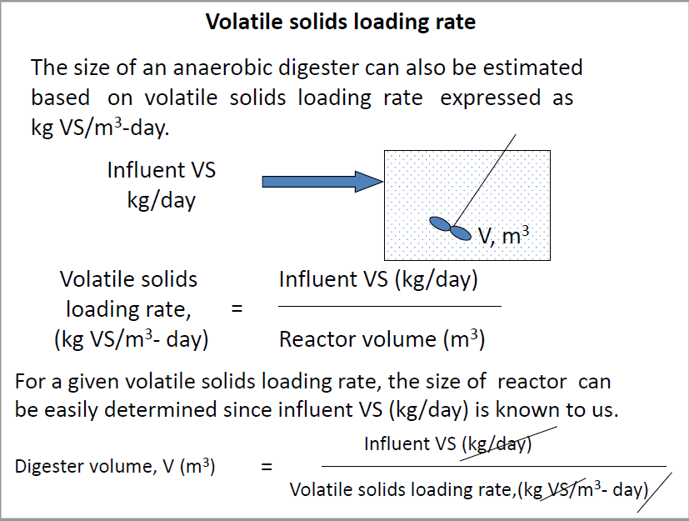

Slide 71
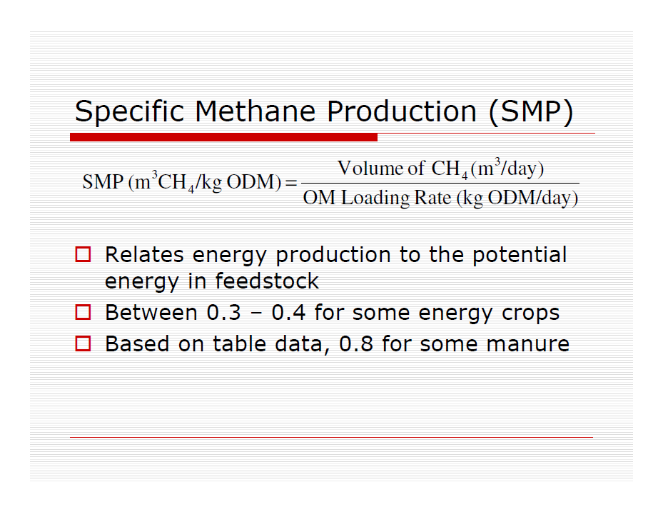
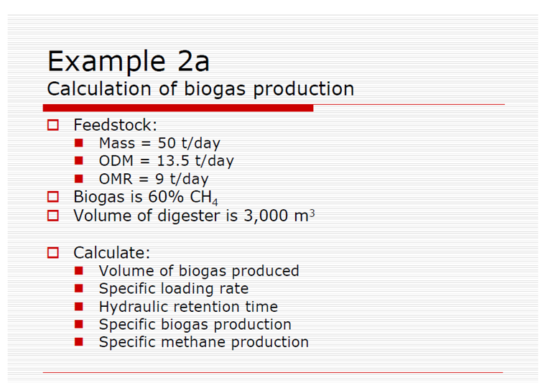

Slide 72
ANAEROBIC SLUDGE DIGESTION
PROCESS
Part(5)

Slide 73
Digestion Factors
ENVIRONMENT
1. ANAEROBIC
No Oxygen
2. TEMPERTURE
Mesophilic - Constant
3. pH
Best - 6.8 to 7.2
4. VOLATILE ACIDS
Not Excessive
5. BUFFERS (Alkalinity)
Incoming Sludge and Created
6. TOXIC MATERIALS
Inhibit Biological Activity

Slide 74
OPERATION AND CONTROL
BALANCE !
Maintaining Suitable Conditions
Maintaining Definite Ranges and Ratios
Organic (Solids) Loading
Alkalinity
Volatile Acids
Temperature
Mixing

Slide 75
3. LOADING
AMOUNT
Applied to the Treatment Process
Related to the SIZE of the System
For An Anaerobic Digestion System – The SIZE Is The VOLUME
Available for Digestion
(Volume - Cubic Feet OR Gallons)

Slide 76
Calculation
of
Digester
Volume
?

Slide 77
r
Volume_{cylinder} =
h₁
Cylinder
Π r²h₁
r
Volume_{cone} =
Cone
h₂
⅓ Π r²h₂

Slide 78
Digester Volume Example Problem
The diameter of a digester is 54 feet.
The side water depth (SWD) is 22 feet.
The cone depth is 12 feet.
Calculate the volume in cubic feet and gallons.
Volume_{cylinder} =
Π r²h₁
=
3.14
X
27 ft
X
27 ft
X
22 ft
= 50,360
ft³
Volume_{cone} =
⅓ Π r²h₂
=
⅓
X
3.14
X
27 ft
X
27 ft
X
12 ft
= 9,156
ft³

Slide 79
Digester Volume Example Problem
Total Volume
= Volume_{cylinder} + Volume_{cone}
= 50,360 ft³ + 9,156 ft³
= 59,516 ft³
Total Volume (gallons) =
cubic feet X 7.48 gal/ft³
= 59,516 ft³ X 7.48 gal/ft³
= 445,180 gallons

Slide 80
Detention Time
DET. TIME (Days) =
Gallons
Gallons / Day)
EXAMPLE
At an average pumping rate of 4,000 gallons per day into a 140,000 gallon digester, the detention time would be:
140,000 gallons
Detention Time
=
4,000 gallons/day
= 35 Days

Slide 81
Percent Volatile Solids
Amount in Question
Total Amount Possible
% =
X 100%
Wt. Of Volatile Solids
% Volatile Solids =
X 100%
Wt. Of Dry Solids
Dry - Ash
% Volatile Solids =
X 100%
Dry

Slide 82




Sludge
100 #
4.2 #
94 #
94%
Water
6 #
70 %
VOLATILE
6 #
TOTAL
SOLIDS
6%
Solids
1.8 #
30 %
ASH
SLUDGE SOLIDS DIAGRAM

Slide 83




BEFORE DIGESTION
AFTER DIGESTION
100,000 Lbs. RAW SLUDGE
CH₄, CO₂, H₂O
(Dry Weight)
DIGESTION CONVERTS
VOLATILES TO
CH₄, CO₂, AND H₂O
50,000 Lbs.
75%
VOLATILE
REMAINING
DIGESTED SLUDGE
75,000 Lbs.
50%
VOLATILE
25,000 Lbs.
25%
FIXED
50%
FIXED
25,000 Lbs.
25,000 Lbs.
TYPICAL RESULTS OF THE DIGESTION PROCESS

Slide 84
SLUDGE
POUNDS
CALCULATIONS

Slide 85
SLUDGE POUNDS CALCULATIONS
Given the following information, calculate the pounds of dry solids and the pounds of volatile solids:
VOLUME OF SLUDGE 8,000 GALLONS
SOLIDS CONCENTRATION 4.2%
VOLATILE SOLIDS 82%
LBS DRY SOLIDS =
LBS
GALS WET
X
8.34
X
% SOLIDS
GAL
LBS
4.2
=
8,000 GAL
X
8.34
X
GAL
100
= 8,000 X 8.34 X 0.042
= 2,802 POUNDS DRY SOLIDS

Slide 86
SLUDGE POUNDS CALCULATIONS
Given the following information, calculate the pounds of dry solids and the pounds of volatile solids:
VOLUME OF SLUDGE 8,000 GALLONS
SOLIDS CONCENTRATION 4.2%
VOLATILE SOLIDS 82%
LBS VOLATILE SOLIDS =
LBS DRY SOLIDS
X
% VOLATILE SOLIDS
82
=
2,802 LBS DRY SOLIDS
X
100
= 2,802 X 0.82
= 2,298 POUNDS VOLATILE SOLIDS

Slide 87
ORGANIC
LOADING
CALCULATIONS

Slide 88
Organic (Solids) Loading Rate
(page 28)
Amount of Volatile Solids Added per Day
Compared to the Size (volume) of the Digester
Amount of V.S.
Organic Loading Rate
=
Volume of Digester
Pounds of Volatile Solids per Day per Cubic Foot
0.02 to 0.10 # Vol. Solids/Day/Ft³
Sometimes as
Pounds of Volatile Solids per Day per 1000 Cubic Feet
20 to 100 # Vol. Solids/Day/1000Ft³

Slide 89
Digester Organic Loading
AMOUNT
of Organic Solids added to a digester
related to the
SIZE
of the digester.
O.L. =
Amount of Organic Solids
Digester Volume
Volatile Solids, pounds /day
O.L. =
Digester Volume, cubic feet

Slide 90
Digester Organic Loading
Data:
Digester Volume = 30,000 ft³
Raw sludge pumped = 9,000 gal/day
Raw sludge solids concentration = 4.0 %
Raw sludge volatile solids = 70.0 %
Calculate the organic loading into the digester in lbs of volatile solids per day per ft³.
LBS VOLATILE SOLIDS =
GAL PUMPED X 8.34 lbs/gal X % Solids (decimal) X % Volatile (decimal)
= 9,000 gal/day X 8.34 lbs/gal X 0.04 x 0.70
= 2,102 lbs/day
2,102 lbs/day
ORGANIC LOADING =
30,000 ft³
= 0.07 lbs/day/ft³

Slide 91
Digester Efficiency
Reduction
Of
Volatile Solids

Slide 92
% Reduction of Volatile Solids
% Reduction of Volatile Solids =
%Volatiles In - % Volatiles Out
X 100%
% Volatile In - ( % Volatile In X % Volatile Out)
% Reduction of Volatile Solids =
In - Out
X 100 %
In - (In X Out)
NOTE: % Must be as Decimals
72%
= 72/100
= .72

Slide 93
% Reduction of Volatile Solids
% Reduction of Volatile Solids =
%Volatiles In - % Volatiles Out
X 100%
% Volatile In - ( % Volatile In X % Volatile Out)
EXAMPLE:
Volatile Solids in Raw Sludge = 68%
Volatile Solids in Digested Sludge = 45%
% Reduction of Volatile Solids =
0.68 – 0.45
X 100%
0.68 – (0.68 X 0.45)
0.68 – 0.45
=
0.23
X 100%
X 100%
0.68 – 0.31
0.37
= 62%

Slide 94
Gas Production
Digesters Produce
Methane and Carbon Dioxide
Normal: 65% to 70% Methane by Volume
Burns: > 56% Methane
Usable as Fuel: > 62% Methane
Healthy Digester Should Produce:
7 to 12 cubic feet/pound vol. solids Destroyed

Slide 95
GAS PRODUCTION CALCULATION
Data:
Raw sludge pumped in per day = 9,000 gallons
Raw sludge solids concentration = 4%
Raw sludge volatile solids = 65%
% Volatile Solids Reduction = 48%
Gas production per day = 8,000 ft³
What is the gas production in terms of cubic feet per pound of volatile solids destroyed?
LBS VOLATILE SOLIDS =
GAL PUMPED X 8.34 lbs/gal X % Solids (decimal) X % Volatile (decimal)
= 9,000 gal/day X 8.34 lbs/gal X 0.04 x 0.65
= 1,951.6 lbs/day
48% of the Volatile Solids were Destroyed
1,951.6 lbs X .48
= 937 lbs Vol. Solids Destroyed

Slide 96
GAS PRODUCTION CALCULATION
Data:
Raw sludge pumped in per day = 9,000 gallons
Raw sludge solids concentration = 4%
Raw sludge volatile solids = 65%
% Volatile Solids Reduction = 48%
Gas production per day = 8,000 ft³
What is the gas production in terms of cubic feet per pound of volatile solids destroyed?
Gas Production, cu.ft. / lb vol. solids Destroyed =
8,000 cu. ft.
937 lbs Vol. Solids Destroyed
= 8.5 cu ft / lb vol. solids destroyed

Slide 97
Energy calculation of biogas plant
Formula to calculate total gas production
For cattle max gas production /kg = 0.05 m3
Total gas =Total dung in kg x 0.05
Calculation for 4 animals each producing 8 kg dung if we are successful to collect that all
Total will be 8x4=32
Total gas=0.05x32 =1.6 m3 if > 1m3 =19 Mega joules
So 1.6x19=30MJ
To convert it to KWh >> 30/3.6 =8.3 KWh

Slide 98
Conversion to electrical energy
Note: when we convert it to electrical energy 65% of energy lost as Heat & other mechanical losses as utilized by electrical generator.
So 8.3*35/100 = 2.91 kWh is available as electrical energy from 32 kg of Cow dung
Consumption
We can run
60watts of 2 bulbs + 1 fan of 80 watts
>>For 12 hours easily…on 2.91 kWh (el) energy

Slide 99
Calculation for cooking
Medium Stove uses 9 MJ of energy /hr
Manure of 3 animals is fuel for stove to run
for 2.5 hrs
8x3=24kg dung =1.2 m3
1.2x19MJ= 22.8 MJ / 9= 2.5 hours

Slide 100
Limitations of biogas plant for a farmer
-The construction costs of biogas plants vary between different countries, they are often high relative to the income of the farmers and other potential users.
-Poor farmers are still lacking behind for adopting this technology because:
-Initial cost of installation of the plant is high.
-Number of cattle owned by an average family of farmers is inadequate to feed a biogas plant.

Slide 101
Benefits of Biogas plant treatment
Waste treatment benefits
natural waste treatment process
mature technology
reduces volume of waste for transport, land application, (vs. not using digestion)
very efficient decomposition
complete biogas capture
nutrient recovery and recycling

Slide 102
Energy benefits
its gives
useful applications, including:
baseload / dispatchable energy source (vs. intermittent wind and solar)
distributed generation (which means lower transmission / transportation costs and higher reliability)
direct replacement for non-renewable fossil fuels

Slide 103
Environmental benefits
dramatic odor reduction
reduced pathogen levels
reduced greenhouse gas emissions
If we utilize these gases so they are not mixing with environment to pollute it.

Slide 104
biological oxygen demand (BOD)
for indirect measurement of the amount of organic pollution (that can be oxidized biologically) in a sample of water. BOD test procedure is based on the activities of bacteria and other aerobic microorganisms (microbes), which feed on organic matter in presence of oxygen. The result of a BOD test indicates the amount of water-dissolved oxygen (expressed as parts per million or milligrams per liter of water) consumed by microbes incubated in darkness for five days at an ambient temperature of 20°C. Higher the BOD, higher the amount of pollution in the test sample. For the contaminants that cannot be oxidized biologically, chemical oxygen demand (COD) method is used.
Read more: http://www.businessdictionary.com/definition/biological-oxygen-demand-BOD.html

Slide 105
ر لمقدار التلوث العضوي (الذي يمكن أكسدته بيولوجياً) في عينة من الماء. يعتمد إجراء اختبار BOD على أنشطة البكتيريا والكائنات الحية الدقيقة الأخرى (الميكروبات) ، التي تتغذى على المادة العضوية في وجود الأكسجين. تشير نتيجة اختبار الأكسجين الحيوي (BOD) إلى كمية الأكسجين المذاب بالماء (المعبر عنها كأجزاء في المليون أو المليغرام لكل لتر من الماء) التي تستهلكها الميكروبات المحتضنة في الظلام لمدة خمسة أيام عند درجة حرارة محيطة تبلغ 20 درجة مئوية. ارتفاع BOD ، أعلى كمية التلوث في عينة الاختبار. بالنسبة للملوثات التي لا يمكن أكسدتها بيولوجياً ، يتم استخدام طريقة الطلب على الأكسجين الكيميائي (COD).

Slide 108
Organic (Solids) Loading Rate
Amount of Volatile Solids Added per Day
Compared to the Size (volume) of the Digester
Amount of V.S.
Organic Loading Rate
=
Volume of Digester
Pounds of Volatile Solids per Day per Cubic Foot
0.02 to 0.10 # Vol. Solids/Day/Ft³
Sometimes as
Pounds of Volatile Solids per Day per 1000 Cubic Feet
20 to 100 # Vol. Solids/Day/1000Ft³

